Slide 1
Brazil R&D My Idea Program GuideDroid
AMPLIFYING SENSES FOR THE VISUALLY IMPAIRED
October, 2013

Slide 2
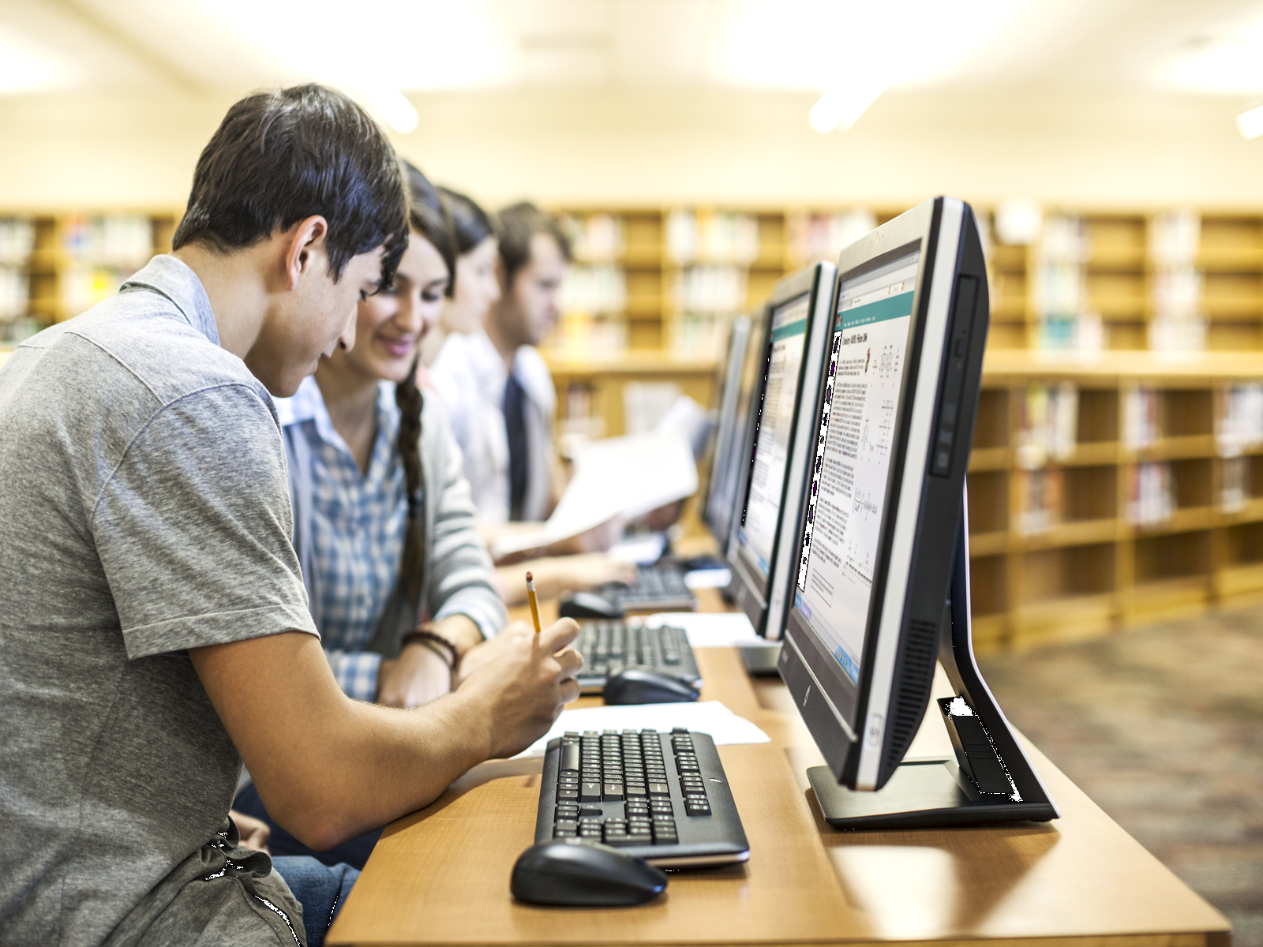
My Idea Program Fostering ideas that worth trying
“An idea that remains on paper never existed.”
Roque Scheer, Brazil R&D

Slide 3

GuideDroid motivation: We Care
Collision risks on ever changing environments
Finding new directions is a big challenge
They can not read posters with warnings
“building a diverse and inclusive culture is the right thing to do”

Slide 4
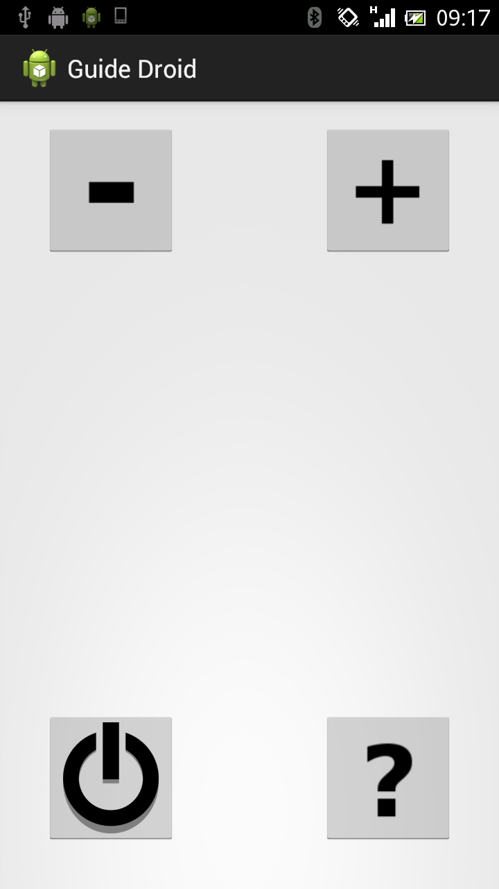
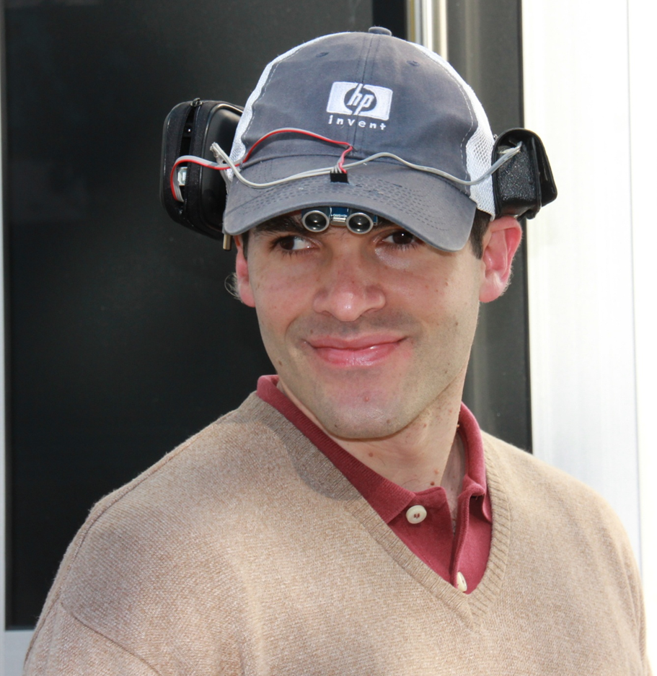
Locomotion helper
Collision avoidance
Smartphone UI not “visual centric”
Very high precision and low power consumption
Technologies
Android smartphone
Arduino w/ ultrasonic sensor
Bluetooth communication with smartphone
Text-to-speech, vibration and beeps

Slide 5
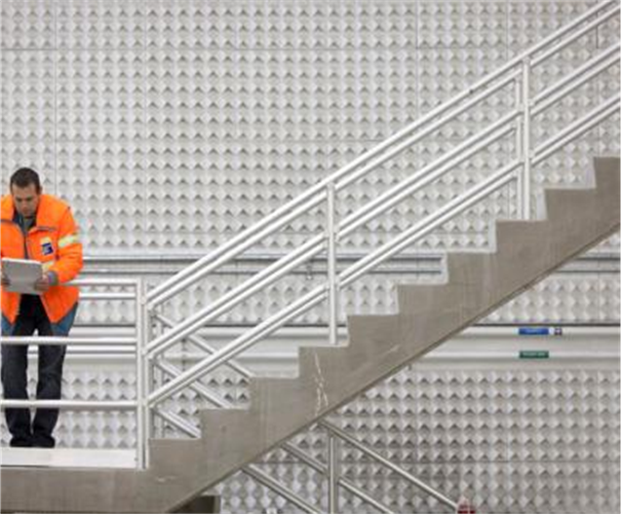

Indoor navigation
Finding new directions
Indoor Navigation Assistant
Turn-by-turn orientation
Application can speak several informations about buildings and rooms
Technologies
Android smartphone with NFC
NFC tags as waypoints
Geodetic coordinates uniformity
Buildings information stored @ HPCloud
Text-to-speech and vibration

Slide 6
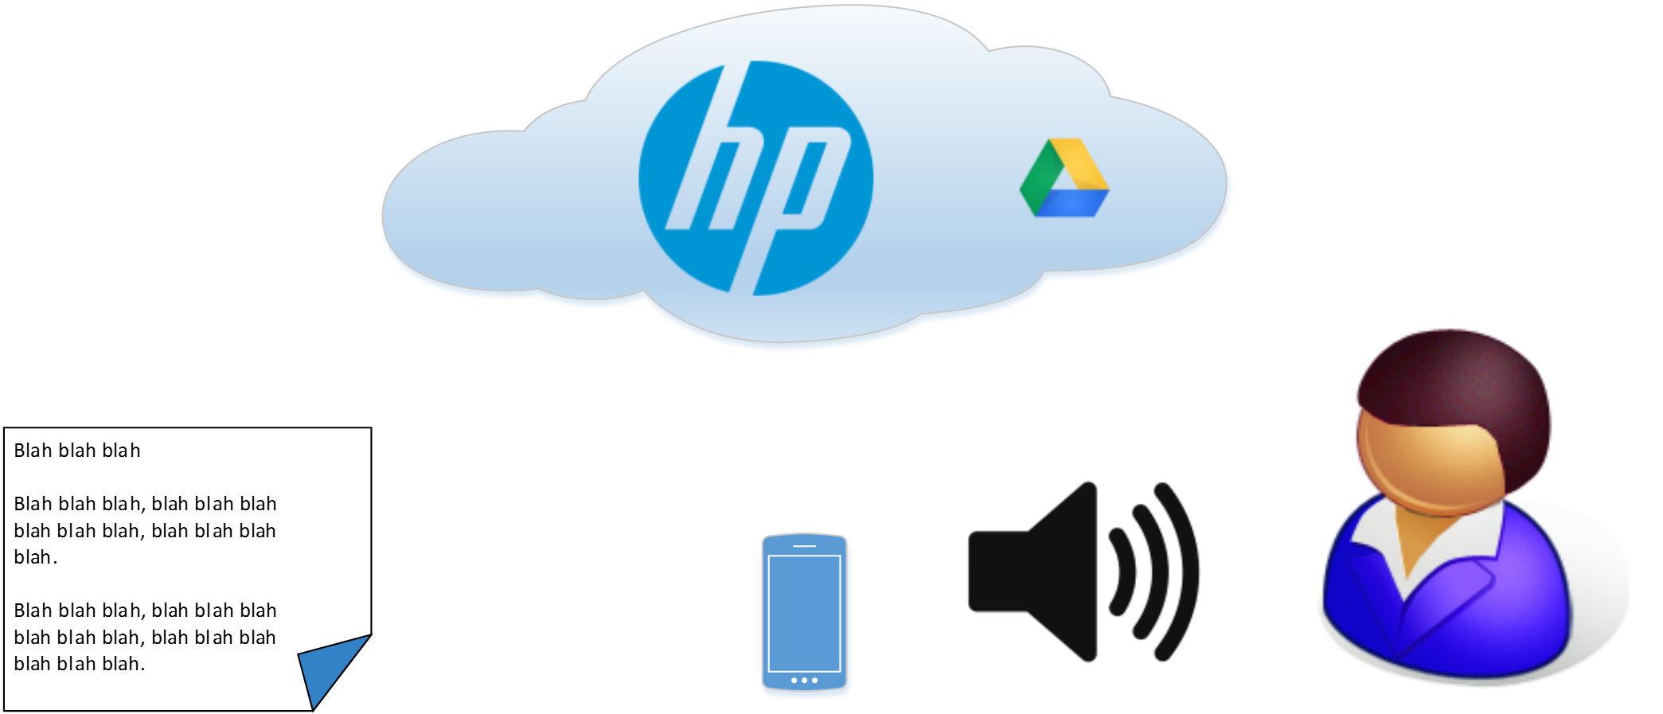
Poster/Sign reader
Reading for the visually impaired
Phone camera captures poster image
Cloud service does OCR
Phone speaks recognized text
Technologies
HP BookPrep
Google Drive API
Google search

Slide 7
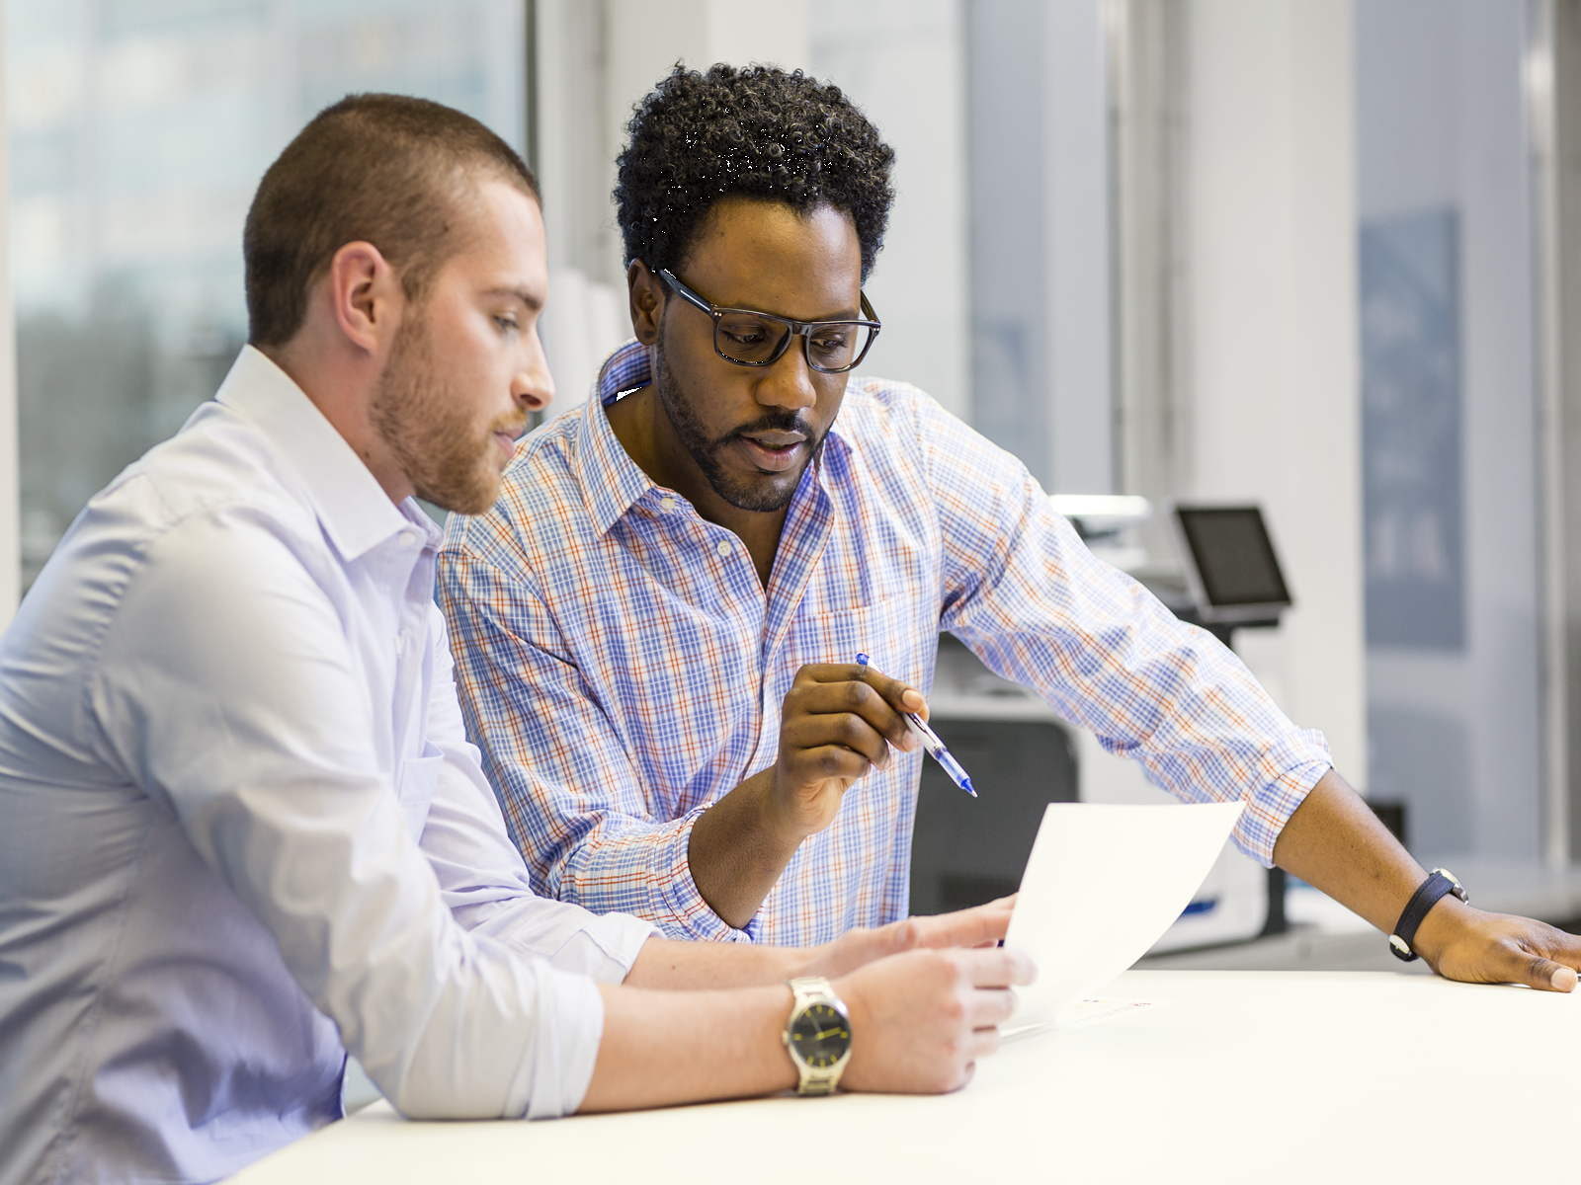
Project guidelines
Uniformity of the geographic location model to ease integration with existing GPS applications
Inexpensive and off-the-shelf components
No changes in buildings infrastructure, no wireless network needed for location
Must be useful for both visually impaired or not

Slide 8

What we did so far
Locomotion helper prototype shown during the first checkpoint (Jun/2013)
Project presented twice during the HP Able Week in Brazil (Aug/2013)
Presented in the Brazil R&D Poster Session 2013 (Oct/2013)
Submitted abstract for the TechCon’14

Slide 9
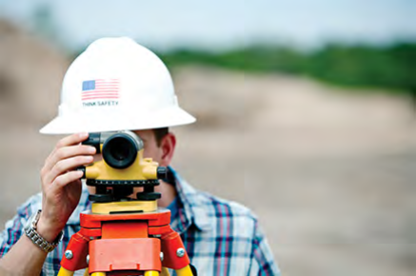
What we are doing
Testing and improving the locomotion helper (demo)
Implementing the indoor navigation system
Investigating better technologic alternatives:
Infrared ink to help locate the indoor signs
Improvements on the captured image to increase the OCR hit rate

Slide 10
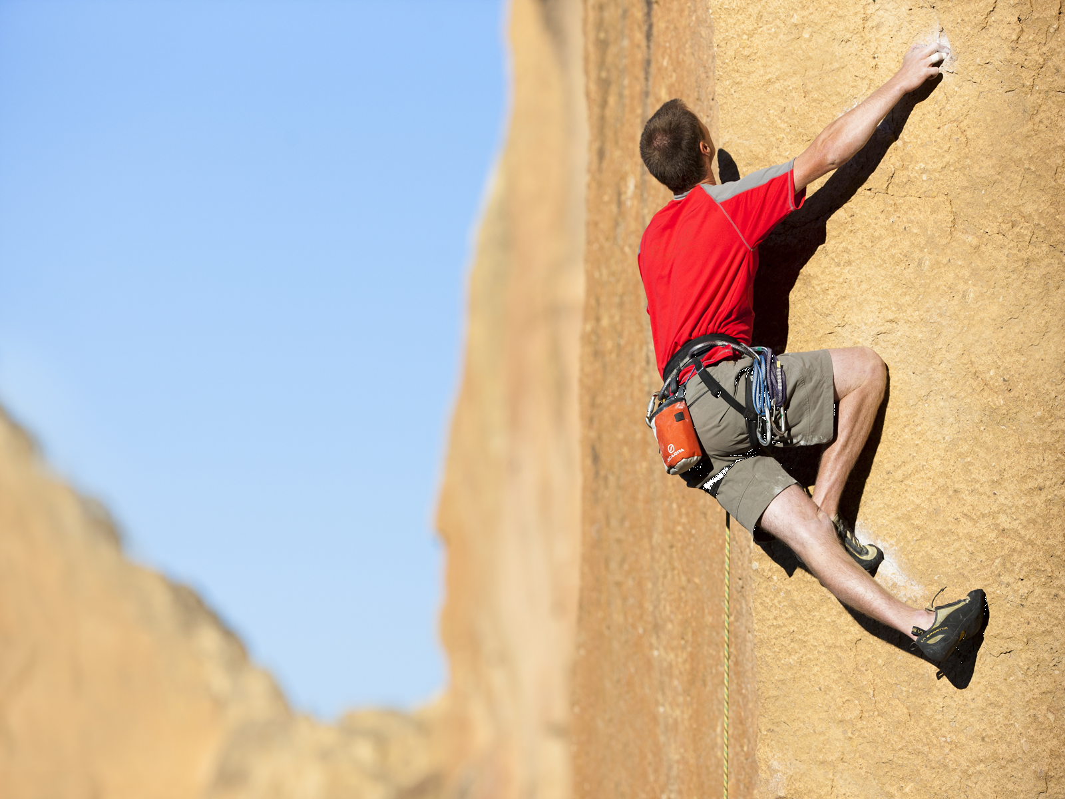
Acknowledgment
All HP BrR&D My Idea Program for the opportunity, great support and confidence.
Our project managers for conciliate our workload.
Candida Moraes and Esabela Cruz for the invite and support during the HP Able Week.
And all friends that helped with suggestions, text review and much more.

Slide 11
Thank you

Slide 12
Backup Slides

Slide 13
